Slide 1
Introduction (Data Mining: Method and Application)
徐华
xuhua@tsinghua.edu.cn

Slide 2
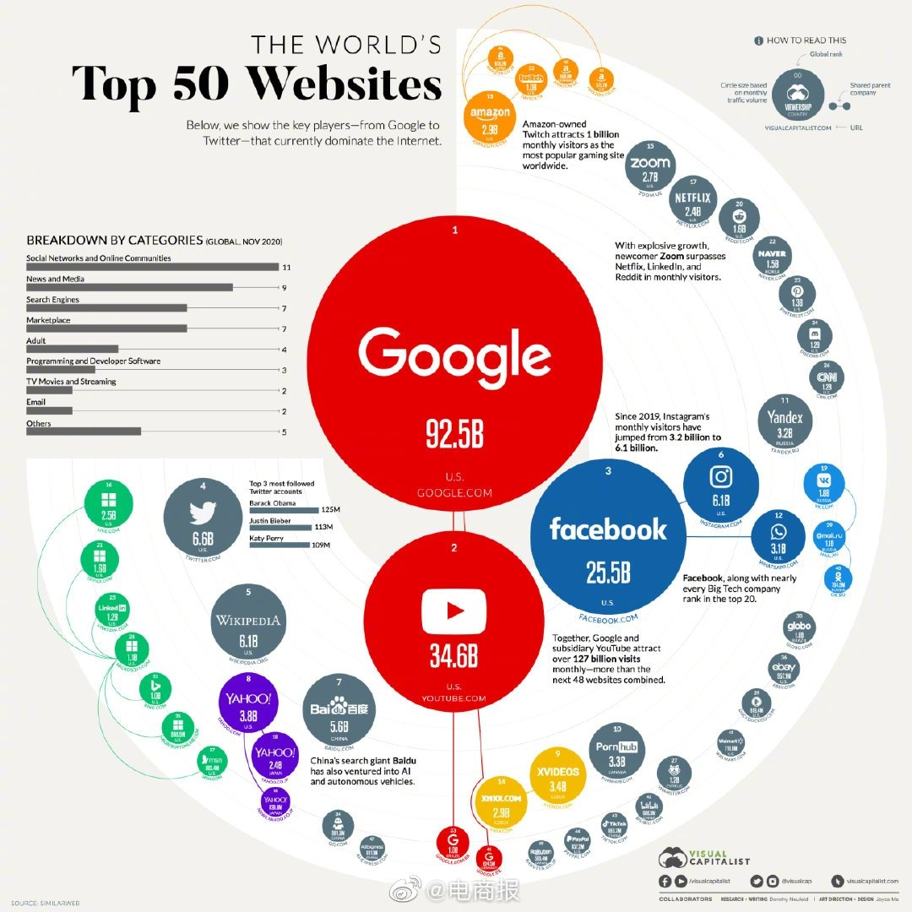
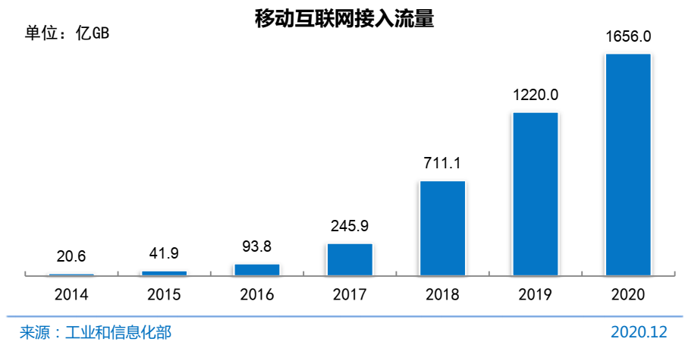
Motivation - Background
The Explosive Growth of Data: from TeraBytes (TB) to PetaBytes (PB): B,KB,MB,GB,TB,PB(Big Data),EB,ZB,YB,DB,NB
Data collection and data availability
Ex. The changing flow of WebPages in China (2020-12)
The Webpage Flow in China from CNNIC(2020-12)

Slide 3
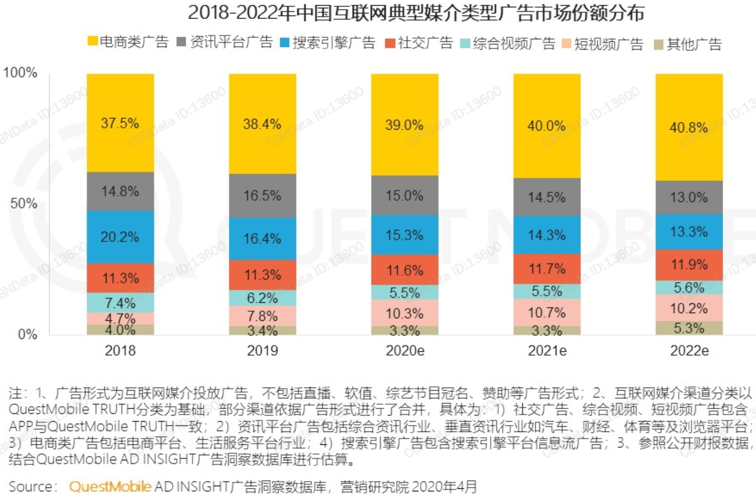
Motivation - Background
About Big Data
> 1PB
“Big Data” is data whose scale, diversity, and complexity require new architecture, techniques, algorithms, and analytics to manage it and extract value and hidden knowledge from it…
Features: “5V”
Volume (规模大)
Variety （种类繁多）
Velocity （速度快）
Veracity （不确定性）
Value （价值）

Slide 4
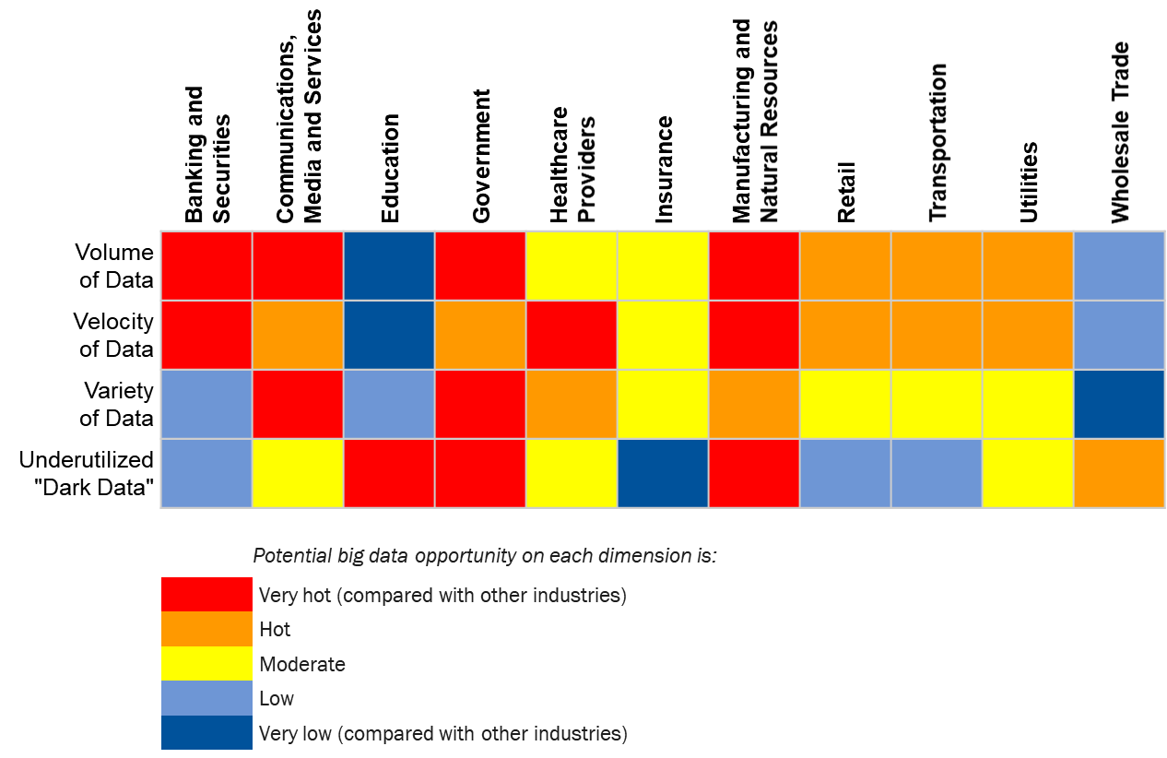
Motivation - Background
Features of Big Data

Slide 5

Motivation-Commercial Viewpoints
Commercial Viewpoints
Data Sources: Web data, e-commerce, purchases at department/grocery stores, Bank/Credit Card, transactions
Computers have become cheaper and more powerful
Competitive Pressure is Strong
Provide better, customized services for an edge (e.g. in Customer Relationship Management)

Slide 6
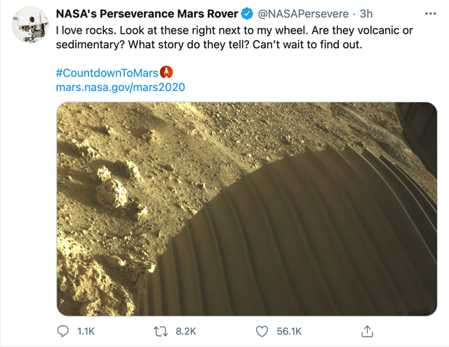
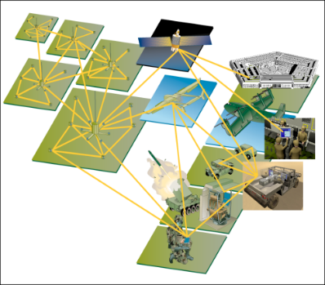
Motivation – Scientific Viewpoints
Scientific Viewpoints
Data collected and stored at enormous speeds (GB/hour)
remote sensors on a satellite
telescopes scanning the skies
microarrays generating gene expression data
scientific simulations generating terabytes of data
Traditional techniques infeasible for raw data
Data mining may help scientists
in classifying and segmenting data
in Hypothesis Formation

Slide 7
Motivation: Why Data mining?
There is often information “hidden” in the data that is not readily evident
Human analysts may take weeks to discover useful information
Much of the data is never analyzed at all. ”We are drowning in data, but starving for knowledge ! ”
“Necessity is the mother of invention”—Data mining—Automated analysis of massive data sets
From: R. Grossman, C. Kamath, V. Kumar, “Data Mining for Scientific and Engineering Applications”

Slide 8
Evolution of Database Technology
1960s:
Data collection, database creation, IMS and network DBMS
1970s:
Relational data model, relational DBMS implementation
1980s:
RDBMS, advanced data models (extended-relational, OO, deductive, etc.)
Application-oriented DBMS (spatial, scientific, engineering, etc.)
1990s:
Data mining, data warehousing, multimedia databases, and Web databases
2000s
Stream data management and mining
Data mining and its applications
Web technology (XML, data integration) and global information systems

Slide 9
What is data mining?
Data mining (knowledge discovery from data)
Extraction of interesting (non-trivial(非平凡的), implicit(隐含的), previously unknown(事先未知) and potentially useful(潜在用途)) patterns or knowledge from huge amount of data
Data mining: a misnomer?
Alternative names
Knowledge Discovery (mining) in databases (KDD)
Knowledge Extraction
Data/pattern Analysis
Data Archeology（数据考古）
Data Dredging（数据捕捞/挖掘）
Information Harvesting
Business Intelligence
Watch out: Is everything “data mining”?
Simple search and query processing
(Deductive) expert systems

Slide 10
Knowledge Discovery Process
⑥Knowledge Visualization
Knowledge
Data mining—Core of Knowledge Discovery Process
⑤Pattern Evaluation
④Data Mining
Task-relevant Data
Selection
③Data Warehouse
②Data Pre-Processing
Data Cleaning, Data Transformation,
Data Integration, Data Reduction
①Data Collection
Database, Tables, Questionnaires, Logs

Slide 11
Data Mining v.s. KDD
Knowledge Discovery in Databases (KDD): process of finding useful information and patterns in data.
Data Mining: Use of algorithms to extract the information and patterns derived by the KDD process.

Slide 12
Data Mining and Business Intelligence
Increasing potential
to support
business decisions
End User
Decision Making
Data Presentation
Business
Analyst
Visualization Techniques
Data Mining
Data
Analyst
Information Discovery
Data Exploration
Statistical Summary, Querying, and Reporting
Data Preprocessing/Integration, Data Warehouses
Data Sources
DBA
Paper, Files, Web documents, Scientific experiments, Database Systems

Slide 13
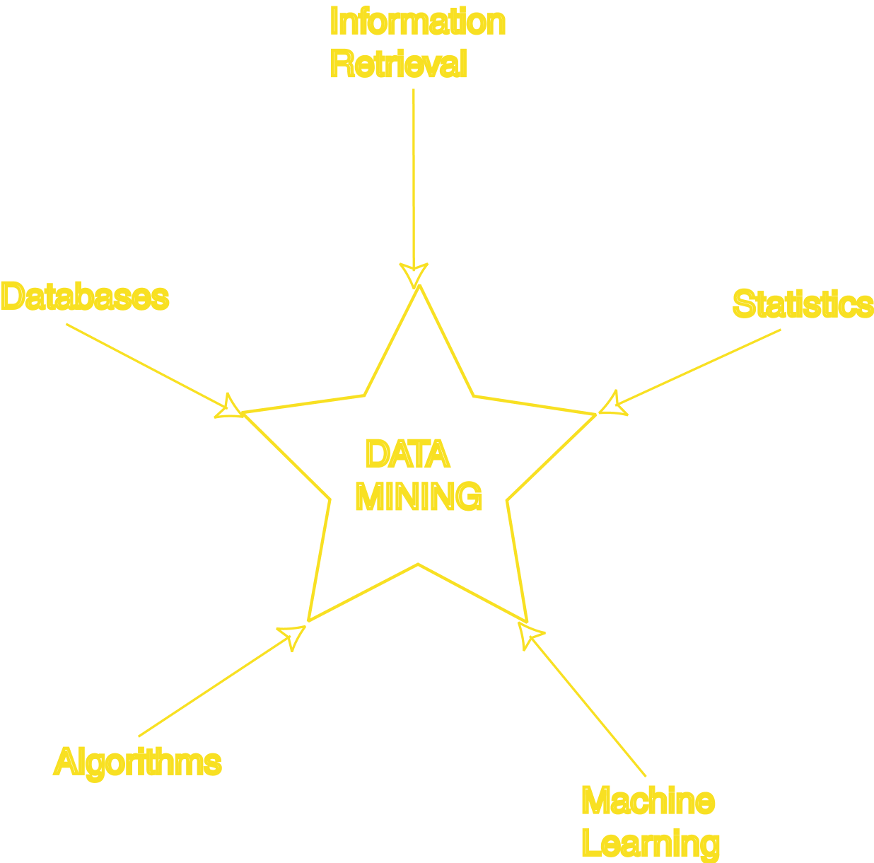
Data Mining: Confluence of Multiple Disciplines
Similarity Measures
Hierarchical Clustering
IR Systems
Imprecise Queries
Textual Data
Web Search Engines
Relational Data Model
SQL
Association Rule Algorithms
Data Warehousing
Scalability Techniques
Bayes Theorem
Regression Analysis
EM Algorithm
K-Means Clustering
Time Series Analysis
Algorithm Design Techniques
Algorithm Analysis
Data Structures
Neural Networks
Decision Tree Algorithms

Slide 14
Why not traditional data analysis?
Tremendous amount of data
Algorithms must be highly scalable to handle such as tera-bytes of data
High-dimensionality of data
Micro-array may have tens of thousands of dimensions
High complexity of data
Data streams and sensor data
Time-series data, temporal data, sequence data
Structure data, graphs, social networks and multi-linked data
Heterogeneous databases and legacy databases
Spatial, spatiotemporal, multimedia, text and Web data
Software programs, scientific simulations
New and sophisticated applications

Slide 15
Multi-Dimensional View of Data Mining
Data to be mined
Relational, data warehouse, transactional, stream, object-oriented/relational, active, spatial, time-series, text, multi-media, heterogeneous, legacy, WWW
Knowledge to be mined
Characterization, discrimination, association, classification, clustering, trend/deviation, outlier analysis, etc.
Multiple/integrated functions and mining at multiple levels
Techniques utilized
Database-oriented, data warehouse (OLAP), machine learning, statistics, visualization, etc.
Applications adapted
Retail, telecommunication, banking, fraud analysis, bio-data mining, stock market analysis, text mining, Web mining, etc.

Slide 16
Data Mining: Classification Schemes
General functionality
Descriptive data mining
Predictive data mining
Different views lead to different classifications
Data view: Kinds of data to be mined
Knowledge view: Kinds of knowledge to be discovered
Method view: Kinds of techniques utilized
Application view: Kinds of applications adapted

Slide 17
Data Mining Functionalities(1)
Multidimensional concept description: Characterization and discrimination
Generalize, summarize, and contrast data characteristics, e.g., Dry v.s. Wet regions
Frequent patterns, association, correlation vs. causality
Diaper →Beer [0.5%, 75%] (Correlation or causality?)
Classification and prediction
Construct models (functions) that describe and distinguish classes or concepts for future prediction
E.g., classify countries based on (climate), or classify cars based on (gas mileage)
Predict some unknown or missing numerical values

Slide 18
Data Mining Functionalities(2)
Cluster analysis
Class label is unknown: Group data to form new classes, e.g., cluster houses to find distribution patterns
Maximizing intra-class similarity & minimizing interclass similarity
Outlier(离群点) analysis
Outlier: Data object that does not comply with the general behavior of the data
Noise or exception? Useful in fraud detection, rare events analysis
Trend and evolution analysis
Trend and deviation: e.g., regression analysis
Sequential pattern mining: e.g., digital camera -> large SD memory
Periodicity analysis
Similarity-based analysis
Other pattern-directed or statistical analysis

Slide 19
About Top-10 DM Algorithms(1)
Classification
#1. C4.5: Quinlan, J. R. C4.5: Programs for Machine Learning. Morgan Kaufmann., 1993.
#2. CART: L. Breiman, J. Friedman, R. Olshen, and C. Stone. Classification and Regression Trees. Wadsworth, 1984.
#3. K Nearest Neighbours (kNN): Hastie, T. and Tibshirani, R. 1996. Discriminant Adaptive Nearest Neighbor Classification. TPAMI. 18(6)
#4. Naive Bayes Hand, D.J., Yu, K., 2001. Idiot's Bayes: Not So Stupid After All? Internat. Statist. Rev. 69, 385-398.
Statistical Learning
#5. SVM: Vapnik, V. N. 1995. The Nature of Statistical Learning Theory. Springer-Verlag.
#6. EM: McLachlan, G. and Peel, D. (2000). Finite Mixture Models. J. Wiley, New York. Association Analysis
#7. Apriori: Rakesh Agrawal and Ramakrishnan Srikant. Fast Algorithms for Mining Association Rules. In VLDB '94.
#8. FP-Tree: Han, J., Pei, J., and Yin, Y. 2000. Mining frequent patterns without candidate generation. In SIGMOD '00.

Slide 20
About Top-10 DM Algorithms(2)
Link Mining
#9. PageRank: Brin, S. and Page, L. 1998. The anatomy of a large-scale hypertextual Web search engine. In WWW-7, 1998.
#10. HITS: Kleinberg, J. M. 1998. Authoritative sources in a hyperlinked environment. SODA, 1998.
Clustering
#11. K-Means: MacQueen, J. B., Some methods for classification and analysis of multivariate observations, in Proc. 5th Berkeley Symp. Mathematical Statistics and Probability, 1967.
#12. BIRCH: Zhang, T., Ramakrishnan, R., and Livny, M. 1996. BIRCH: an efficient data clustering method for very large databases. In SIGMOD '96.
Bagging and Boosting
#13. AdaBoost: Freund, Y. and Schapire, R. E. 1997. A decision-theoretic generalization of on-line learning and an application to boosting. J. Comput. Syst. Sci. 55, 1 (Aug. 1997), 119-139.

Slide 21
About Top-10 DM Algorithms(3)
Sequential Patterns
#14. GSP: Srikant, R. and Agrawal, R. 1996. Mining Sequential Patterns: Generalizations and Performance Improvements. In Proceedings of the 5th International Conference on Extending Database Technology, 1996.
#15. PrefixSpan: J. Pei, J. Han, B. Mortazavi-Asl, H. Pinto, Q. Chen, U. Dayal and M-C. Hsu. PrefixSpan: Mining Sequential Patterns Efficiently by Prefix-Projected Pattern Growth. In ICDE '01.
Integrated Mining
#16. CBA: Liu, B., Hsu, W. and Ma, Y. M. Integrating classification and association rule mining. KDD-98.
Rough Sets
#17. Finding reduct: Zdzislaw Pawlak, Rough Sets: Theoretical Aspects of Reasoning about Data, Kluwer Academic Publishers, Norwell, MA, 1992
Graph Mining
#18. gSpan: Yan, X. and Han, J. 2002. gSpan: Graph-Based Substructure Pattern Mining. In ICDM '02.

Slide 22
About Top-10 DM Algorithms(4)
Selected at ICDM2007
#1: C4.5 (61 votes)
#2: K-Means (60 votes)
#3: SVM (58 votes)
#4: Apriori (52 votes)
#5: EM (48 votes)
#6: PageRank (46 votes)
#7: AdaBoost (45 votes)
#7: kNN (45 votes)
#7: Naive Bayes (45 votes)
#10: CART (34 votes)

Slide 23
Major Issues in Data Mining
Mining methodology
Mining different kinds of knowledge from diverse data types, e.g., bio, stream, Web
Performance: efficiency, effectiveness, and scalability
Pattern evaluation: the interestingness problem
Incorporation of background knowledge
Handling noise and incomplete data
Parallel, distributed and incremental mining methods
Integration of the discovered knowledge with existing one: knowledge fusion
User interaction
Data mining query languages and ad-hoc mining
Expression and visualization of data mining results
Interactive mining of knowledge at multiple levels of abstraction
Applications and social impacts
Domain-specific data mining & invisible data mining
Protection of data security, integrity, and privacy

Slide 24




Textbook
Data Mining: Methods and Applications（Second Edition）
by XU HUA
Tsinghua University Publishers, March 2022.
ISBN: 978-7-302-60144-9
ISBN: 978-7-302-36901-1
Data Mining: Methods and Applications—Application Examples
by XU HUA
Tsinghua University Publishers, Aug 2017.
ISBN: 978-7-302-47211-7

Slide 25
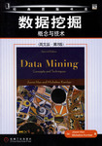


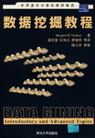
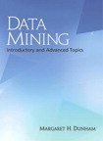
References(1)
Data Mining: Concepts and Techniques
by Jiawei Han & Micheline Kamber
Morgan Kaufmann Publishers, March 2006.
ISBN: 1-55860-901-6
数据挖掘教程
Margaret H.Dunham 著，郭崇慧，田凤占，靳晓明等译
清华大学出版社, 2005年5月.
ISBN: 7-302-10533-2
Data Mining: Introductory and Advanced Topics
by Margaret H. Dunham
Prentice Hall; Aug 2002
ISBN-10: 0130888923

Slide 26
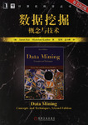

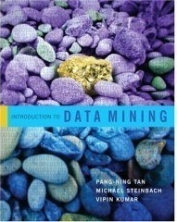
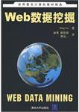

References(2)
数据挖掘概念与技术（原书第3版）
韩家炜，堪博 著，范明，孟小峰 译
机械工业出版社，2007年3月
ISBN：9787111205388
Introduction to Data Mining
by Pang-Ning Tan, Michael Steinbach, Vipin Kumar
Addison Wesley; May 2005
ISBN-13: 978-0321321367
Web数据挖掘
Bing Liu 著，余勇，薛贵荣，韩定一 译
清华大学出版社，2009年4月
ISBN：978-7-302-19338-8

Slide 27
A Brief History of Data Mining Society
1989 IJCAI Workshop on Knowledge Discovery in Databases
Knowledge Discovery in Databases (G. Piatetsky-Shapiro and W. Frawley, 1991)
1991-1994 Workshops on Knowledge Discovery in Databases
Advances in Knowledge Discovery and Data Mining (U. Fayyad, G. Piatetsky-Shapiro, P. Smyth, and R. Uthurusamy, 1996)
1995-1998 International Conferences on Knowledge Discovery in Databases and Data Mining (KDD’95-98)
Journal of Data Mining and Knowledge Discovery (1997)
ACM SIGKDD Conferences since 1998 and SIGKDD Explorations
More conferences on data mining
PAKDD (1997), PKDD (1997), SIAM-Data Mining (2001), (IEEE) ICDM (2001), etc.
ACM Transactions on KDD starting in 2007

Slide 28
Conferences
KDD: ACM SIGKDD Int. Conf. on Knowledge Discovery in Databases and Data Mining
KDD08, KDD09 , KDD10 , KDD11 , KDD12, KDD13, KDD14, KDD15
SDM: SIAM Data Mining Conf.
SDM08, SDM09, SDM10, SDM11, SDM12 , SDM13, SDM14, SDM15
ICDM: IEEE Int. Conf. on Data Mining
ICDM08, ICDM09, ICDM10, ICDM11, ICDM12, ICDM13, ICDM14, ICDM15
PKDD : Conf. on Principles and Practices of Knowledge Discovery and Data Mining
PKDD08, PKDD09, PKDD10, PKDD11, PKDD12, PKDD13, PKDD14, PKDD15
PAKDD: Pacific-Asia Conf. on Knowledge Discovery and Data Mining
PAKDD08, PAKDD09, PAKDD10, PAKDD11, PAKDD12, PAKDD13,PAKDD14, PAKDD15

Slide 29



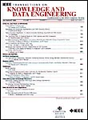


Journals
Data Mining and Knowledge Discovery
Geoffrey I. Webb
http://springer.lib.tsinghua.edu.cn/
清华IP可直接登录
IEEE Trans. On Knowledge and Data Eng.
Xindong Wu
http://ieeexplore.ieee.org/xpl/RecentIssue.jsp?punumber=69
清华IP直接登录
SIGKDD Explorations
Osmar R. Zaiane
http://www.sigkdd.org/explorations/issue.php?issue=current
清华IP直接登录

Slide 30
Internet Resources(1)
UCI数据集: http://kdd.ics.uci.edu/
CMU数据集： http://lib.stat.cmu.edu/datasets/
http://www.cs.cmu.edu/afs/cs.cmu.edu/project/theo-20/www/data/
时序数据集： http://www.stat.wisc.edu/~reinsel/bjr-data/
金融数据集： http://lisp.vse.cz/pkdd99/Challenge/chall.htm
癌症基因数据集： http://www.broadinstitute.org/cgi-bin/cancer/datasets.cgi
综合数据集：http://www.cs.nyu.edu/~roweis/data.html
数据集列表：http://www.kdnuggets.com/datasets/index.html
美国政府开放数据：http://data.gov
中国地方政府开放数据：北京 http://www.bjdata.gov.cn/
上海 http://datashanghai.gov.cn

Slide 31
Internet Resources(2)
UCI机器学习网站 http://archive.ics.uci.edu/ml/
Weka官方网站 http://www.cs.waikato.ac.nz/ml/weka/
DBMiner官方网站 http://ddm.cs.sfu.ca/
SVM代码 http://www.csie.ntu.edu.tw/~cjlin/libsvm/
代码与数据集开源社区 https://github.com/
其它开源软件包： NB（朴素贝叶斯网络），NN（神经网络），DT（决策树）
相关软件：Matlab，StatSoft等商用软件；SQL Server 2008中也提供了相应的Data Analysis数据分析工具

Slide 32
Relative Courses
Arizona
Australian
Bilkent
CMU
Central Connecticut
Central Washington
Cornel
Depaul
Georgia
HKUST
IIT, Indian
McMaster
Nanjing
NUAA
New York
Pennsylvania
Purdue
RPI
Rutgers
Standford
Alberta, Canada
Wright State
MIT
Berkeley
Helsinki, Finland
Illinois
Illinois at UC
Massachusetts
Minnesota
Austin (1)(2)
Toronto
Washington
Uppsala, Sweden
VirginiaTech, USA

Slide 33
Summary
Data mining: Discovering interesting patterns from large amounts of data
A natural evolution of database technology, in great demand, with wide applications
A KDD process includes data cleaning, data integration, data selection, transformation, data mining, pattern evaluation, and knowledge presentation
Mining can be performed in a variety of information repositories
Data mining functionalities: characterization, discrimination, association, classification, clustering, outlier and trend analysis, etc.
Data mining systems and architectures
Major issues in data mining

Slide 34
Recommended Reference Books
S. Chakrabarti. Mining the Web: Statistical Analysis of Hypertex and Semi-Structured Data. Morgan Kaufmann, 2002
R. O. Duda, P. E. Hart, and D. G. Stork, Pattern Classification, 2ed., Wiley-Interscience, 2000
T. Dasu and T. Johnson. Exploratory Data Mining and Data Cleaning. John Wiley & Sons, 2003
U. M. Fayyad, G. Piatetsky-Shapiro, P. Smyth, and R. Uthurusamy. Advances in Knowledge Discovery and Data Mining. AAAI/MIT Press, 1996
U. Fayyad, G. Grinstein, and A. Wierse, Information Visualization in Data Mining and Knowledge Discovery, Morgan Kaufmann, 2001
J. Han and M. Kamber. Data Mining: Concepts and Techniques. Morgan Kaufmann, 2nd ed., 2006
D. J. Hand, H. Mannila, and P. Smyth, Principles of Data Mining, MIT Press, 2001
T. Hastie, R. Tibshirani, and J. Friedman, The Elements of Statistical Learning: Data Mining, Inference, and Prediction, Springer-Verlag, 2001
B. Liu, Web Data Mining, Springer 2006.
T. M. Mitchell, Machine Learning, McGraw Hill, 1997
G. Piatetsky-Shapiro and W. J. Frawley. Knowledge Discovery in Databases. AAAI/MIT Press, 1991
P.-N. Tan, M. Steinbach and V. Kumar, Introduction to Data Mining, Wiley, 2005
S. M. Weiss and N. Indurkhya, Predictive Data Mining, Morgan Kaufmann, 1998
I. H. Witten and E. Frank, Data Mining: Practical Machine Learning Tools and Techniques with Java Implementations, Morgan Kaufmann, 2nd ed. 2005

Slide 35
概述部分结束！
Notes:
工作新意图发现

